Slide 1
Information System Design
How we can specify an Information System under development?
Information System Design
Notes:
Lecture# 02
July 26. 2007
IT60105: D Samanta, SIT, IIT Kharagpur

Slide 2
An Example: SANJOG
Internet access to underdeveloped communities in India
In recent years, with the exponential growth of Information Technology (IT), Internet has spread almost in all applications. However, the Internet advantages are confined to the limited communities only in our country. The majority communities, who have some inherent limitations such as illiteracy, unfamiliarity with foreign languages, cyber ignorance, low-bandwidth communication links etc. are still unable to participate in the IT revolution. An IS can be planned to give a solution that transcend these barriers and bring Internet services to everyone.
Information System Design
Notes:
Lecture# 02
July 26. 2007
IT60105: D Samanta, SIT, IIT Kharagpur

Slide 3
ICT to Rural India
Title of the Information System
SANJOG: An Interface to WWW for Rural India
Information System Design
Notes:
Lecture# 02
July 26. 2007
IT60105: D Samanta, SIT, IIT Kharagpur

Slide 4
Objectives of SANJOG
Support Internet access to backward communities in India in their mother languages.
Design and development of Indian languages (Hindi and Bengali) with compatible user interface (browser).
Providing multi-modal interactions facilities for user-friendly interaction to Internet, so that people of varieties level of experience can enjoy the system.
Information System Design
Notes:
Lecture# 02
July 26. 2007
IT60105: D Samanta, SIT, IIT Kharagpur

Slide 5
Specification of SANJOG
System:
  An integrated systems meeting all the objectives of the project.
Subsystems:
  Browser interface compatible with Hindi
  Browser interface compatible with Bengali
  Voice enabled interface and information retrieval
  Icon-based man-cyber interaction
  Dialogue-based information access
  E-mail based off-line Internet access
Information System Design
Notes:
Lecture# 02
July 26. 2007
IT60105: D Samanta, SIT, IIT Kharagpur

Slide 6
Typical End User of SANJOG
Rural communities in the belt of Hindi and Bengali languages
Other relevant applications in state and central government offices
Research communities
Information System Design
Notes:
Lecture# 02
July 26. 2007
IT60105: D Samanta, SIT, IIT Kharagpur

Slide 7
Technical Details of SANJOG
Urgency of the proposed system
Aim and Challenges
Solution
  Architectural level
Work plan
  Planning, Analysis, Design, Implementation and testing
Information System Design
Notes:
Lecture# 02
July 26. 2007
IT60105: D Samanta, SIT, IIT Kharagpur

Slide 8
Urgency of SANJOG
The spectacular growth in Internet, which becomes synonymous with the World Wide Web (WWW), makes a rapid advancement in Information and Communication Technology (ICT). However, the explosive growth of ICT and its many applications in education, science, services and other activities etc. are confined within a limited number of so called privileged people, who live in digital pockets. In fact, the rural people in our country are yet to be included in this ICT revolution. It is not so worth to mention that the overall growth of the country depends on the growth of the rural human resources in India. Further, the rural population is 76% of the overall population in India and with reference to the intellectuality they are also no way inferior compared to their urban counterparts. In order to diminish the imbalance it is therefore an urgent need to make an info-communications bridges between Rural India and the Internet. There are so many odds to achieve this like computer illiteracy, language barrier, low-bandwidth communication connectivity, inadequate training facilities etc. are some reasons. It therefore makes a challenge for us to extend it towards the underprivileged community in India. This issue need to be addressed and find a solution in ICT for Rural India. This system will be an indigenous effort to design and develop an integrated framework with which the Indian people in general and the rural people in particular will be able to share the WWW in their mother languages. Otherwise some digital revolution takes place, it is not expected to get any breakthrough in the existing telecommunication infrastructure in the present decade and anticipating this scenario a novel solution has been proposed to overcome the low-bandwidth communication limitation to access the Internet by rural mass.
Information System Design
Notes:
Lecture# 02
July 26. 2007
IT60105: D Samanta, SIT, IIT Kharagpur

Slide 9
Aim and Challenges in SANJOG
Currently Internet becomes synonymous with World Wide Web (WWW). The popularity of WWW is largely dependent on the search engines. Search engines are the access point of the huge information repository at the internet. The user interface of the existing search engines takes a query string as an input from the user. Based on the keywords present in the query string they search for relevant documents. This type of interface works fine for well literate people. But for illiterate people or those who has not enough proficiency and expertise to construct a good query strings cannot use this. The rural communities in India are a perfect example of this category of users. Hardly, they have the proficiency of constructing a good query strings in English to extract their information from WWW. These problems are compounded when novice users come into the consideration. These categories of computer illiterate users have a huge gulf between “search and information”. Another, limitations for rural users is having very slow rate of information access, because of the low-bandwidth connectivity to the Internet, which severally discourages them to be associated with the cyber world.
SANJOG is proposed to give a solution that transcend these barriers and bring Internet services to everyone in Rural India.
Information System Design
Notes:
Lecture# 02
July 26. 2007
IT60105: D Samanta, SIT, IIT Kharagpur

Slide 10
Blue Print of SANJOG
(An architectural level solution)
Information System Design
Notes:
Lecture# 02
July 26. 2007
IT60105: D Samanta, SIT, IIT Kharagpur

Slide 11
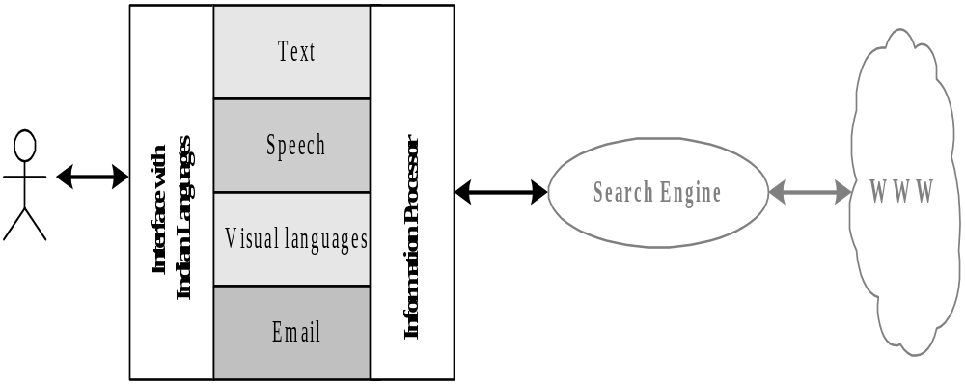
Basic Architecture of SANJOG
Information System Design
Notes:
Lecture# 02
July 26. 2007
IT60105: D Samanta, SIT, IIT Kharagpur

Slide 12
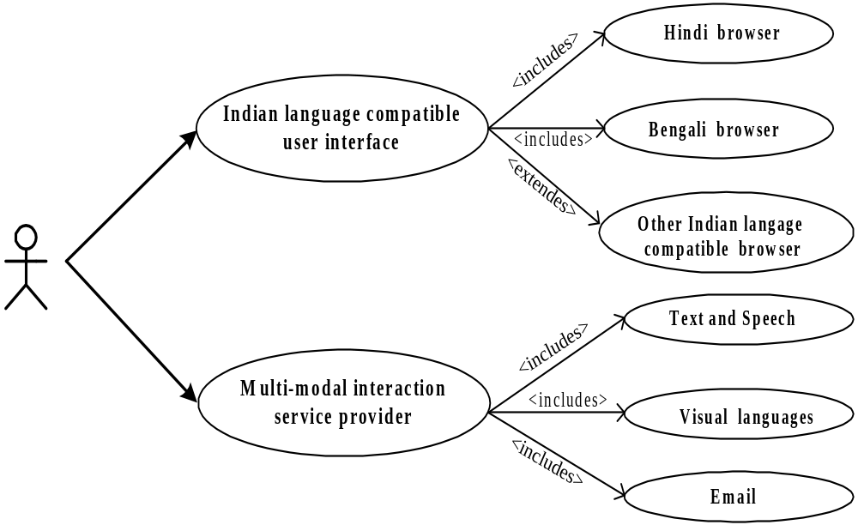
Use Case Diagram of SANJOG
Information System Design
Notes:
Lecture# 02
July 26. 2007
IT60105: D Samanta, SIT, IIT Kharagpur

Slide 13
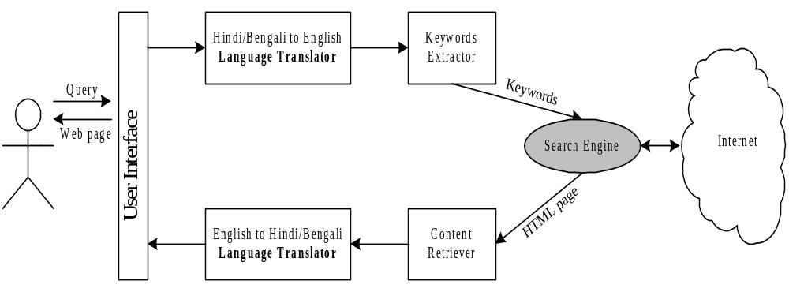
Architecture of Indian Language Compatible Browser
Information System Design
Notes:
Lecture# 02
July 26. 2007
IT60105: D Samanta, SIT, IIT Kharagpur

Slide 14
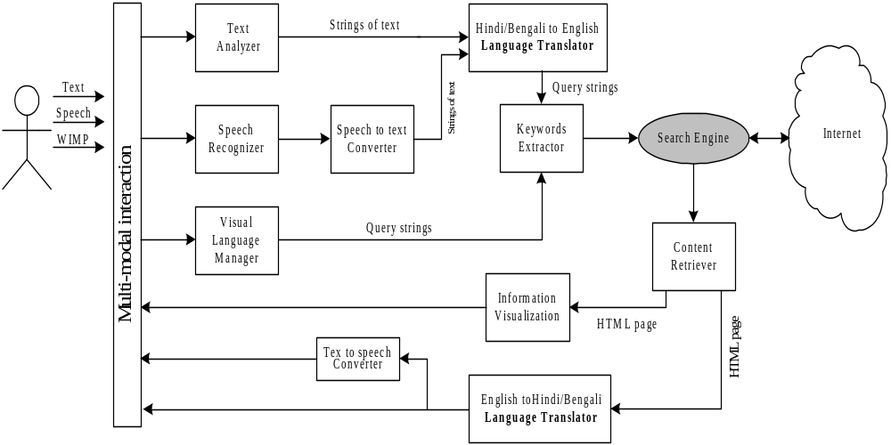
Architecture of the Multi-modal User Interface Component
Information System Design
Notes:
Lecture# 02
July 26. 2007
IT60105: D Samanta, SIT, IIT Kharagpur

Slide 15
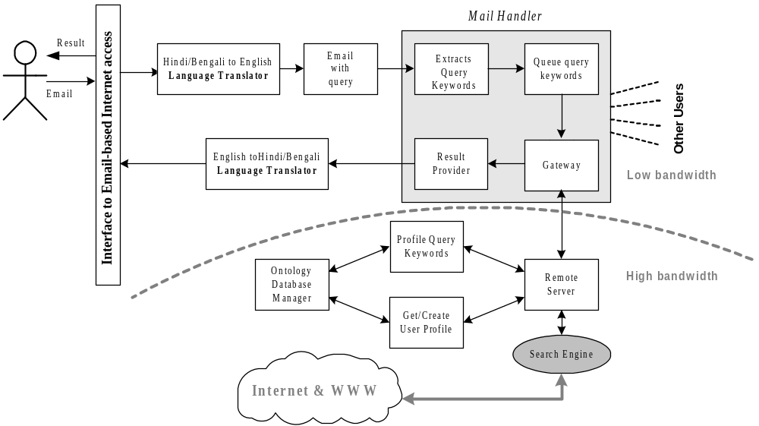
Architecture of the Component that Access Internet through Email
Information System Design
Notes:
Lecture# 02
July 26. 2007
IT60105: D Samanta, SIT, IIT Kharagpur

Slide 16
Work Plan
Duration of the project: 36X6 PM months
Year 1
  Browser interface compatible with Hindi
  Browser interface compatible with Bengali
Year 2
  Voice enabled interface and information retrieval
  Icon-based man-cyber interaction
  Dialogue-based information access
Year 3
  E-mail based off-line Internet access
Information System Design
Notes:
Lecture# 02
July 26. 2007
IT60105: D Samanta, SIT, IIT Kharagpur

Slide 17
Requirements
Hardware?
Software??
Others ???
Information System Design
Notes:
Lecture# 02
July 26. 2007
IT60105: D Samanta, SIT, IIT Kharagpur

Slide 18
Towards the deliverables……
Planning?
Analysis?
Design?
Implementation?
Testing?
Deployment?
Information System Design
Notes:
Lecture# 02
July 26. 2007
IT60105: D Samanta, SIT, IIT Kharagpur

Slide 19
Exercises
Discuss Information Systems (IS).
Explain the technology, people, and organizational components in information systems.
Identify a case study similar to SANJOG. Discuss its architectural description.
Information System Design
Notes:
Lecture# 02
July 26. 2007
IT60105: D Samanta, SIT, IIT Kharagpur

